Slide 1
The Current and Future State of Non-Geostationary Orbit (NGSO) Fixed-Satellite Service (FSS) Interference Regulation Metrics
Lieselotte (Lilo) Heinrich, Braden Oh, Whitney Lohmeyer
AIAA ASCEND 2023
Notes:
My name is Lilo Heinrich, I’m a senior at Olin College of Engineering, and I will be presenting on the Current and Future State of Non-Geostationary Orbit Fixed-Satellite Service Interference Regulation Metrics.
This research was done with the Olin Satellite + Spectrum Technology & Policy group under Professor Whitney Lohmeyer, who is currently on leave from Olin to serve as the FCC Space Bureau’s Chief Technologist.

Slide 2
Outline
Current Spectrum Sharing Rules
Degraded Throughput
Revising Spectrum Sharing Rules
Future Spectrum Sharing Rules

Slide 3
Current Spectrum Sharing Rules
1
Notes:
First, I will give some background on the current state of NGSO FSS Spectrum Sharing Rules.

Slide 4


Background
The Federal Communications Commission (FCC) and the International Telecommunications Union (ITU) define radiocommunication rules and spectrum allocations
Spectrum sharing rules require review to protect existing systems from harmful interference and promote efficient use of spectrum
Notes:
With thousands of NGSO satellites planned to be launched in the coming years, there is a growing risk of radio frequency interference between co-frequency satellite systems, which degrades performance.
Radio frequency spectrum is a limited resource, regulated by the Federal Communications Commission in the United States and the International Telecommunications Union globally.
Spectrum sharing rules require review to protect existing systems from harmful interference and promote efficient use of spectrum.

Slide 5
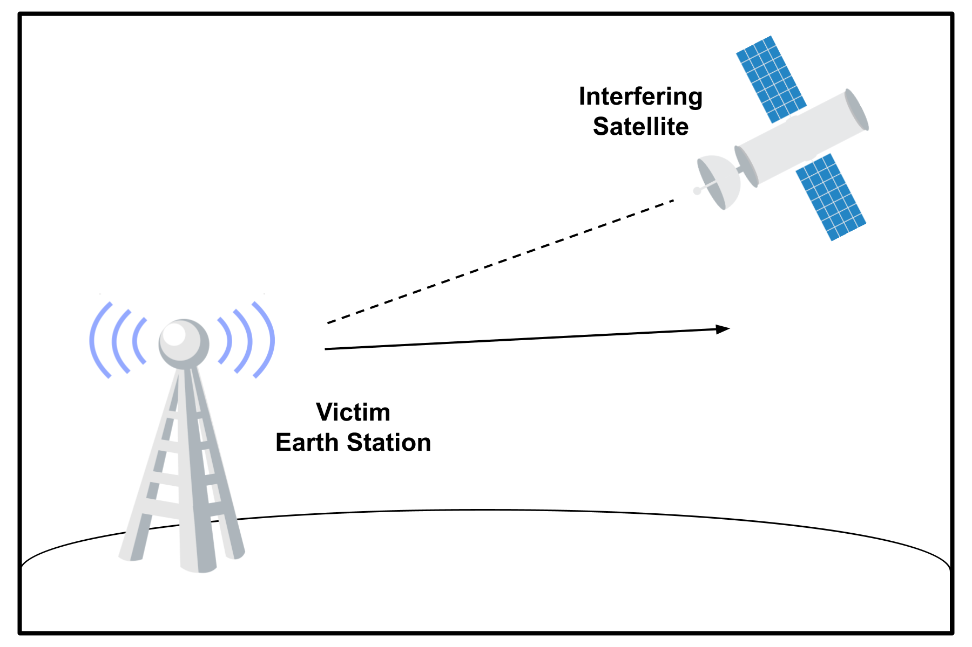
Current Metric: Interference to Noise
Notes:
A key metric used to assess and regulate the likelihood of interference from NGSO systems into earth stations is the interference-to-noise ratio, which is measured in decibels.
I/N compares the strength of an interfering signal, I, to the strength of the background thermal noise, N, of a system and is determined similarly to a link budget calculation between a satellite ‘interferer’ and a ‘victim’ earth station.

Slide 6
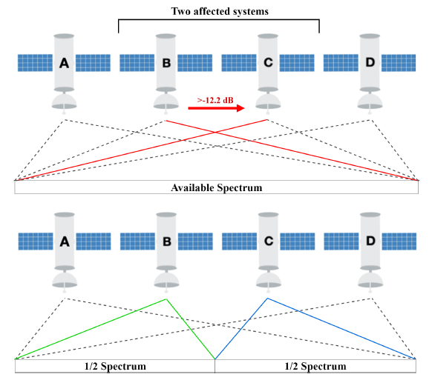
I/N Coordination Trigger
-12.2 dB I/N threshold
ITU:
Coordination agreement
FCC:
Coordination agreement or demonstrate they will not cause harmful interference
Default spectrum splitting procedure
Notes:
The ITU recommends that NGSO FSS operators conduct coordination, while the FCC allows operating without coordination agreements if the operator demonstrates that they will not cause harmful interference.
The FCC also uses an I/N ‘coordination trigger’, where if a victim receiver experiences I/N levels greater than -12.2 dB and coordination can not be reached, then a “default spectrum splitting” procedure goes into effect, which restricts each of the 𝑛 operators to transmit in only 1/𝑛 of the assigned spectrum while the threshold is exceeded.
Operating with decreased bandwidth reduces performance, so this encourages completing coordination agreements to avoid band segmentation.

Slide 7
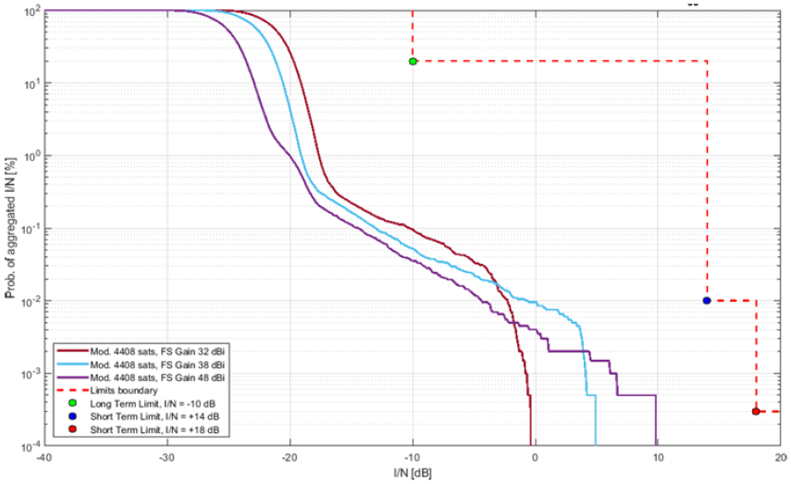
Dynamic I/N Thresholds
ITU-R F.1495 permissible interference regulation:
Long-term: I/N should not exceed –10 dB for more than 20% of any year.
Short-term: I/N should not exceed +14 dB for more than 0.01% and +18 dB for more than 0.0003% of any month.
Notes:
Another type of regulation the ITU uses is a permissible I/N regulation.
For example, this recommendation to protect fixed service operations states that I/N should not exceed –10 dB for more than 20% of any year, as well as shorter term limits.
A probabilistic approach is used to calculate the I/N levels produced by a satellite constellation into victim earth stations.
The result, as shown in this figure, is a time-weighted function describing the percent of time that the I/N level exceeds some value.
To show compliance to the dynamic threshold, the aggregated I/N must not cross the dashed line delineating the long- and short-term limits. In this figure, the system complies.
Dynamic I/N regulations allow producing larger I/N levels for brief periods of time, making it a more tailored type of regulation which increases allowable spectrum usage.

Slide 8
Generic versus System-Specific Parameters
ITU: Generic victim fixed service earth station parameters
FCC: Accepts filings based on either system-specific or ITU-recommended generic parameters
Standard reference antenna mask and noise temperature value
Notes:
The ITU defines parameters for a generic fixed service earth station to be used as the victim in I/N calculations, whereas the FCC accepts filings that are based on either system-specific or ITU-recommended generic parameters.
These parameters include a standard reference antenna mask and noise temperature value.

Slide 9
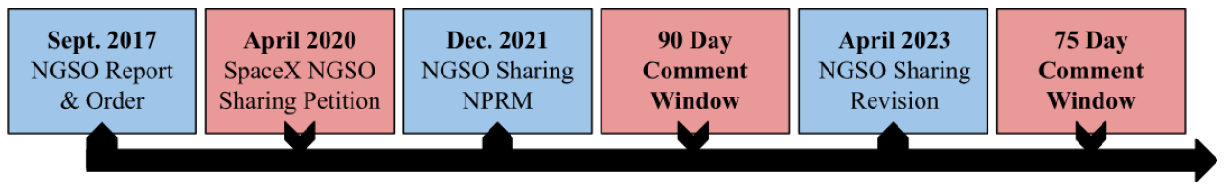
Timeline of Rulemaking
Notes:
Now, I will go over a timeline of rulemaking on spectrum sharing.
In September 2017, the FCC released a Report and Order which updated rules for NGSO FSS Systems and sought to remove regulatory obstacles for companies proposing to provide satellite broadband internet, including defining the I/N coordination trigger and default spectrum splitting procedure.
Additionally, the FCC licenses NGSO FSS systems in “processing rounds” that occur on an irregular basis triggered by either a new applicant or the FCC itself. The FCC ruled that the default spectrum-splitting procedure would be quote “initially limited” to applicants in the same processing round, and later-round applicants would be considered on a case-by-case basis to protect expectations and investments while still allowing for new entry.
In April 2020, SpaceX proposed changes to clarify the spectrum sharing obligations, including using an I/N limit to define the obligation of later-round systems to protect earlier-round systems.
The FCC responded to SpaceX’s petition with a Notice of Proposed Rulemaking, and finally, in April 2023 the FCC released a Report and Order and Further Notice of Proposed Rulemaking which adopted several changes.

Slide 10
Revising Spectrum Sharing Rules
2
Notes:
Next, we will look at SpaceX’s Petition and the FCC’s response.

Slide 11
2020 SpaceX Spectrum Sharing Petition
Proposal 1: Limit the default spectrum-splitting procedure to systems authorized within the same processing round.
Proposal 2: Later-round systems should protect earlier-round systems up to a specified I/N level.
Proposal 3: This protection should sunset.
Proposal 4: Systems be required to share beam-pointing information to facilitate interference analyses.
Notes:
In their petition, SpaceX argued that clarifying the spectrum sharing obligations and protections across processing rounds would increase certainty about the future spectrum sharing environment which may be helpful to both current operators and prospective entrants.
The first proposal was to limit the default spectrum-splitting procedure to systems authorized within the same processing round. (CLICK) The FCC responded favorably and proposed to adopt this as a rule.
The next two proposals were that later-round systems should protect earlier-round systems up to a specified I/N level, but that this protection should sunset. (CLICK) The FCC agreed that later-round systems should be required to protect earlier-round systems by a quantitative limit but did not necessarily agree that I/N was the most appropriate metric to use in defining this limit and invited comments on the matter. (CLICK) The FCC responded favorably to sunsetting protections.
Finally, SpaceX proposed requiring operators to share beam-pointing data to facilitate interference analysis. (CLICK) The FCC did not favor this proposal due to concern about competitive harm.

Slide 12
2021 FCC Spectrum Sharing NPRM
Developing a dynamic I/N limit
Burden on applicants
May not sufficiently protect sensitive antennas
Could disincentivize coordination
Notes:
Circling back to proposal 2, SpaceX suggested the use of a dynamic I/N limit although they did not propose specific values.
The FCC expressed concern about how such a limit would be defined and invited comments on specific values.
Furthermore, static I/N considered only the worst-case geometry at a single point in time, whereas probabilistic analysis considers the interference from the constellation over many points in time, increasing modeling complexity.
Requiring applicants to perform probabilistic analysis for potentially thousands of satellites, some which may never be launched, could place undue burdens on entrants.
Another concern is that I/N may not provide sufficient protection to sensitive antennas because it would not consider the parameters of the system to be protected, and an I/N limit could discourage coordination if licensees preferred to operate within this limit.
The FCC invited further comments on how to establish this protection.

Slide 13
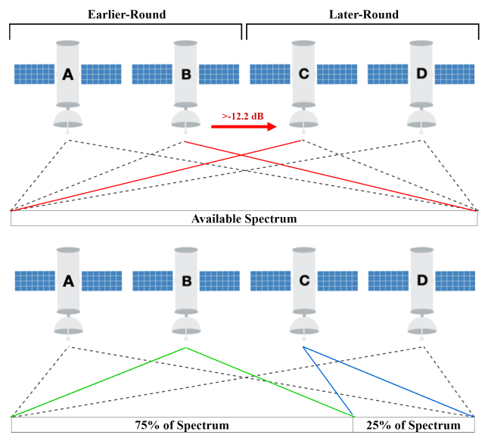

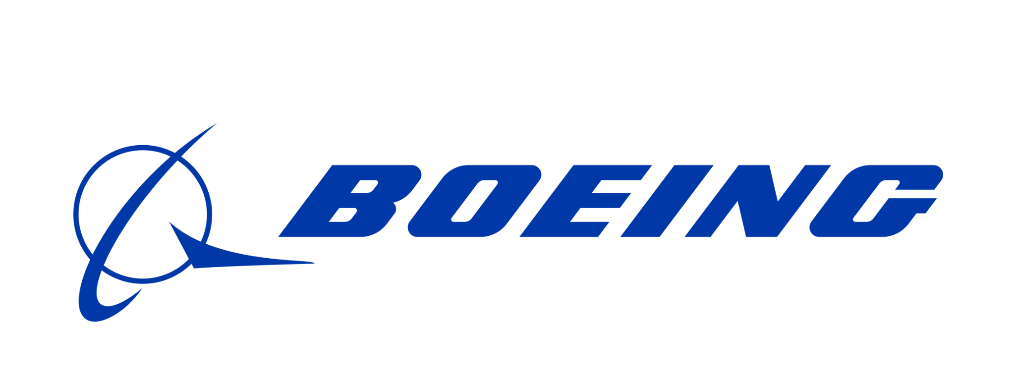
75/25 Spectrum Split
Notes:
Commenters expressed their opinion on an I/N limit and proposed alternative metrics.
First, Boeing and O3b perceived problems with existing metrics and instead proposed granting earlier-round systems 75% of the available spectrum during an interfering event, rather than defining an interference limit. While this may initially sound unfair, it eliminates the need for complex and burdensome calculations and assumes that later-round systems will require less bandwidth to provide the same service on account of more advanced technology.

Slide 14








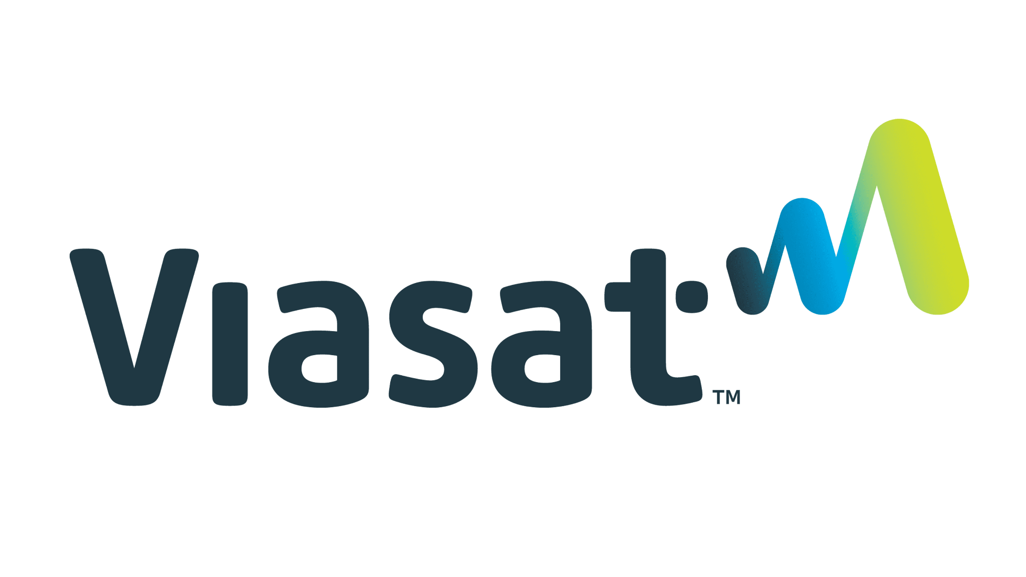

I/N Limit
For static I/N:
1 dB
Against I/N:
1 dB
-15.2 dB
For dynamic I/N:
Notes:
Three commenters advocated for the continued use of a static I/N limit, although there was no consensus on whether to raise or lower the limit. Kepler proposed -15.2 dB, while OneWeb and SpinLaunch expressed that the existing -12.2 dB limit was “overly conservative” and advocated raising the limit to 1 dB.
Additionally, SpaceX, Hughes, and AST suggested a dynamic I/N limit but proposed no specific thresholds.
Opponents of I/N argued that it does not effectively protect real-world systems because I/N is calculated with respect to a generic victim system, simultaneously resulting in over-protection of robust systems and under-protection of sensitive systems. Public Interest Organizations point out that conservative I/N limits result in unused spectrum capacity that could be more fully utilized with coordination agreements.

Slide 15

Degraded Throughput
Against:
For:
Notes:
Commenters also proposed degraded throughput, which quantifies the performance degradation that an interfering system causes to a victim system.
Hughes argued that spectrum efficiency metrics are flawed because they benefit some technologies over others, and O3b argued that a degraded throughput would require a significant amount of information about every system’s links and operations.
Advocates pointed out that degraded throughput can be calculated with respect to real world systems, allowing interference to be regulated with respect to–and potentially up to the limit of–causing actual harm, allowing spectrum to be more efficiently utilized.
All together, these proposals indicate growing concern with I/N and an increased support for degraded throughput.

Slide 16
Degraded Throughput
3

Slide 17
Kuiper’s Proposal
Kuiper proposed adopting a metric providing that a later-round NGSO FSS system may cause:
“(1) at most an increase of 3% of the time allowance for the earlier-round system’s lowest carrier-to-noise ratio (C/N) value; and
(2) at most a 3% reduction in the time-weighted average spectral efficiency of an earlier-round system, calculated on an annual basis.”
Advances harmonization with ITU
Notes:
Amazon’s Project Kuiper proposed regulating the protection of earlier-round systems using a degraded throughput metric providing that a later-round NGSO FSS system may cause:
“at most an increase of 3% of the time allowance for the earlier-round system’s lowest carrier-to-noise (C/N) ratio value;”
and secondly, “at most a 3% reduction in the time-weighted average spectral efficiency of an earlier-round system, calculated on an annual basis.”
This matches provisions in Article 22.5L of the ITU Radio Regulations which protect GSO operations from NGSO systems in V-band, so adopting this metric would advance the harmonization with ITU rules.

Slide 18
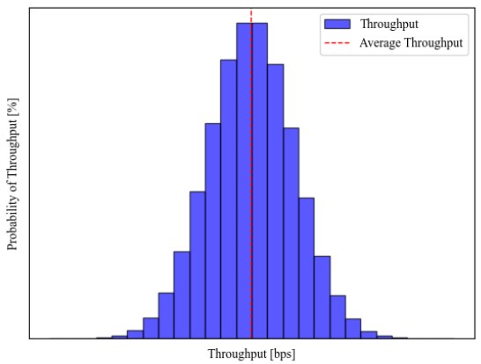
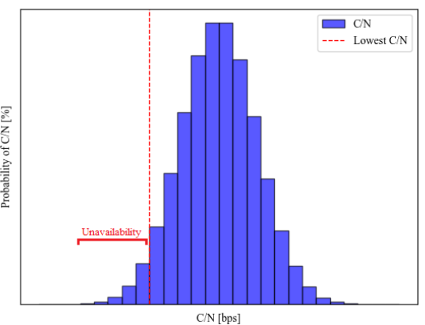
What is Degraded Throughput?
Notes:
Carrier to noise ratio
Kuiper’s proposed regulation uses Carrier-to-Noise ratio which evaluates the strength of a desired signal between a transmitter and a receiver.
Spectral efficiency / throughput
Spectral efficiency, also referred to as throughput, (hence the name ‘degraded throughput’), is a measure of the amount of data in bits per second (bps) that a satellite can transmit in a unit reference of spectrum (Hz) and can be calculated as a function of C/N.
The left figure shows a time-weighted function of throughput, with the average throughput illustrated by a dashed red line.
Part one of Kuiper’s proposal limits the reduction in the time-weighted average throughput that an interfering system may cause to a victim system, which protects against long-term interference impacting data throughput.
Availability
Next, the amount of time that a victim system operates at or below its lowest C/N value is also known as the time allowance for link unavailability. When a link falls below its minimum C/N value, the system cannot effectively transmit data at the designed rates.
Setting a time allowance that an interfering system may cause link unavailability to a victim system, as Kuiper does in part two of their proposal, protects against short-term high intensity interference.
The right figure shows time-weighted C/N, with the lowest C/N threshold delineated by a dashed red line. The unavailability time is the fraction of time that C/N is below this threshold.
Requirements for both unavailability and throughput degradation are necessary to create a complete measure of both long-term and short-term interference.

Slide 19
Benefits of Degraded Throughput
NGSO satellites are subject to dynamic effects
Dynamic path loss, antenna gain, rain attenuation
Adaptive control and modulation (ACM) balances availability and throughput
Recognize resiliency to decreases in availability and throughput
Compare system performance with and without interference
Tailored protection of victim systems allows efficient use of spectrum
Notes:
NGSO satellites are subject to dynamic effects including dynamic path loss, changes in antenna gain, and rain attenuation. To withstand dynamic effects and maintain service, most modern satellites use adaptive control and modulation to actively adapt their signals to balance link availability and throughput.
A degraded throughput methodology would recognize that NGSO systems already must be resilient against signal degradation and link unavailability, so they are also resilient against interference caused by other NGSO systems.
Essentially, degraded throughput compares the performance that a system expects to achieve against the performance it would achieve with the interference of another system.
Tailoring interference protections to the effects caused on victim systems, rather than needlessly constraining interfering systems, maximizes spectrum sharing among operators.

Slide 20
Drawbacks of Degraded Throughput
Complexity of calculation
Generic or system-specific parameters
With generic: does not protect all systems equally
With specific: tailored protections, increases burden on applicants
Definition of lowest C/N of a system
Notes:
1. Complexity of Calculation & System Parameters
The complexity of preventing interference between NGSO systems has grown alongside the need to maximize the use of shared spectrum.
One drawback of degraded throughput is that it is complex to calculate, placing a greater burden on entrants.
It’s unclear whether the FCC will require the use of system-specific parameters, meaning that later-round systems would have to calculate degraded throughput for each earlier-round system, increasing this burden.
However, tailoring to system-specific parameters would make degraded throughput superior at assessing the impact to performance of a victim system and allow for maximizing shared spectrum use.
2. Strict Definitions
Additionally, there is not yet a guideline for defining the lowest C/N of a system; unavailability does not refer to a complete outage, but rather a system operating below its ‘nominal’ or expected ability. A loose definition of lowest C/N opens a potential loophole in which an operator not acting in good-faith defines an arbitrarily high C/N value to place restrictions on competitors.

Slide 21
Future of Spectrum Sharing Rules
4
Notes:
Now, we will look at the latest update and what it might mean for the future.

Slide 22
2023 FCC Spectrum Sharing Revision
Change 1: Limit default spectrum-splitting procedure to same-round systems.
Change 2: Later-round systems must complete coordination agreements with earlier-round systems or demonstrate that they will protect earlier-round systems using a degraded throughput methodology.
Change 3: This protection will sunset.
Change 4: NGSO FSS grantees must coordinate with each other in good faith.
Comments on “appropriate values and assumptions”
Notes:
The FCC’s 2023 Revision to NGSO Spectrum Sharing rules adopted several changes:
The first was to limit the default spectrum-splitting procedure to systems authorized within the same processing round.
The next was that later-round systems must either complete coordination agreements with earlier-round systems or demonstrate that they will protect earlier-round systems by using a degraded throughput methodology. This protection will sunset, after which later-round systems will return to the default spectrum-splitting procedure.
Lastly, all NGSO FSS grantees must coordinate with each other in good faith.
The FCC sought comments about “appropriate values and assumptions” to be used under a degraded throughput methodology.

Slide 23
Methodology Considerations
Rain Attenuation
Aggregate Interference
Modeling Assumptions
Threshold Values
Degraded Throughput Analysis Tool
Notes:
Finally, I will discuss some of the considerations in defining a degraded throughput methodology.
A. Rain Attenuation
First is whether to account for rain attenuation, which can have a significant effect on signal strength in higher frequencies.
Some systems compensate by increasing transmission power dynamically, which is called uplink power control (UPC).
While adding rain attenuation makes the model more realistic, it also brings the threshold for unavailability closer and impacts spectral efficiency in a non-linear manner.
B. Aggregate Interference
Secondly, the aggregate interference from multiple constellations into a victim system may reach harmful levels even while the thresholds for single-system interference are not exceeded. Degraded throughput methodology may be expanded to include multiple interfering constellations, increasing the complexity. An open question is how a regulation on aggregate interference might be defined.
C. Modeling Assumptions
Thirdly, the results of probabilistic analysis are sensitive to modeling assumptions.
For example, C/N and I/N are sensitive to the off-axis angle between the transmitter’s beam and the boresight of the receiving antenna.
In their 2020 dynamic I/N analysis, SpaceX made several worst-case assumptions including using worst-case off-axis angles, allowing them to simplify the model and ensure that they did not underestimate interference.
However, requiring worst-case assumptions may unnecessarily increase restrictions on interferers.
D. Threshold Values
Next, Kuiper proposed 3% thresholds based on a provision for protecting GSO systems. Whether this is also appropriate for NGSO systems is unclear, since there are differences in the design and goals of GSO and NGSO systems so further analysis may be required to determine appropriate thresholds.
E. Degraded Throughput Analysis Tool
Finally, creating a software tool to perform degraded throughput analysis may reduce the burden on entrants and standard input file formats could allow NGSO operators to share the information needed for this analysis in a concise manner.

Slide 24
Conclusion
Degraded throughput as a replacement for I/N could increase spectral efficiency and modernize satellite interference regulation.
However, further clarification and specificity about the methodology for calculation is needed.
Notes:
In conclusion, degraded throughput as a replacement for I/N could increase spectral efficiency and modernize satellite interference regulation.
However, further clarification and specificity about the methodology for calculation is needed.

Slide 25
Thank you! Any Questions?
Notes:
It depends…
That’s a good question. I haven’t looked into that.

